Slide 1

FOOD ORDERING SYSTEM
FullStack Presentation
GLA University
Department of CEA
Presented By:
Mohan Agrawal (181500385)
Madan Mohan (181500354)
Udit Aggarwal(181500765)
Shubham sharma(181500696) Submitted To: Mr. Pankaj kapoor

Slide 2
Introduction
It is web based application that provide the interface to user for order the food from your favorite hotels .
It gives a dashboard to Hotels for management their details and deliveries.
The focus of this project is to managing the hotel details on single website from where user can choose the restaurant and order the food.

Slide 3
Problem Statement
Food ordering is not a big deal in modern time because there is a lot of food ordering websites but there is need of fresh food and details of hotels where it comes for became healthy. So, need this another system.
There are some places where food is not delivered on time due to lack of reachable places of single restaurant but here, there more than hundred restaurant that join our system so that it increase the probability of getting food at every place.

Slide 4
Objective
The primary object of food ordering system is to provide the list of restaurant to users for choosing the food.
To produce a web-based system that allows the hotels to manage their information on single dashboard.
Every individual would be able to compare the cost of food according the hotels.

Slide 5
System Requirements
1. Hardware Requirements:
PC with 4GB RAM, 500 GB HDD
I3 Processor
2. Software Requirements:
XAMPP web server 1.0.0.0
VS code editor 1.46.1.0
GitHub Repository

Slide 6
Languages Used
HTML5
CSS
JavaScript
PHP 7.1.33.0
My SQL database
Bootstrap 4

Slide 7
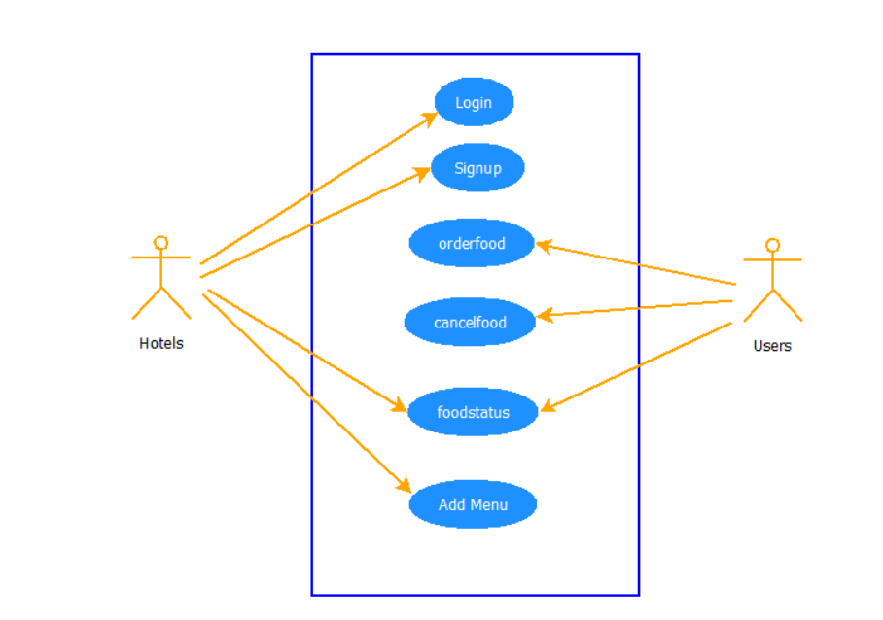
Software Design
Use Case Diagram:

Slide 8
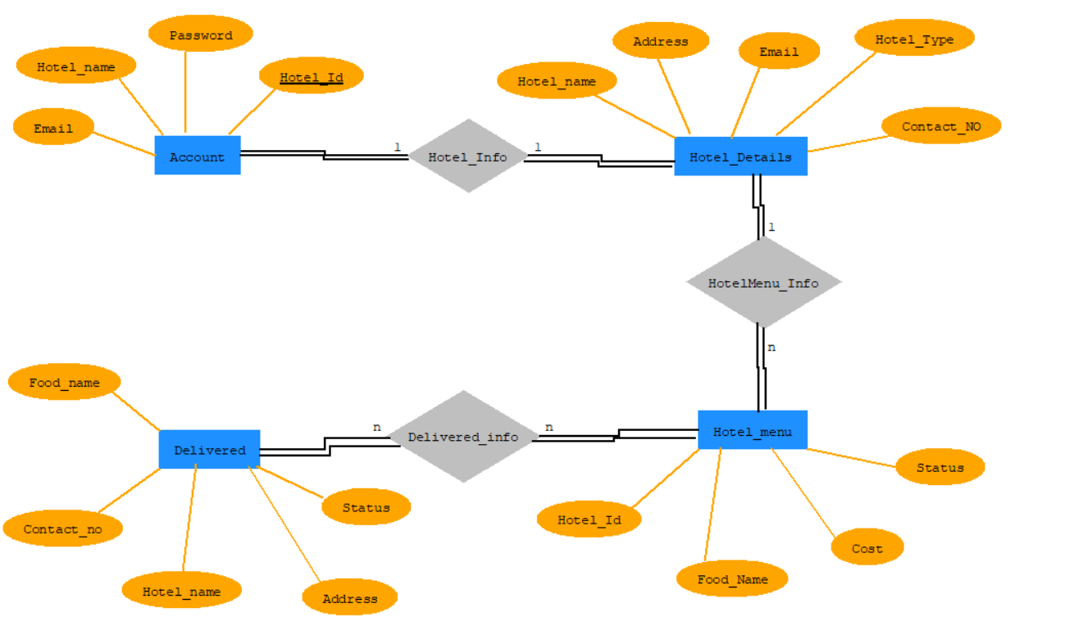
Software Design
ER Diagram:

Slide 9
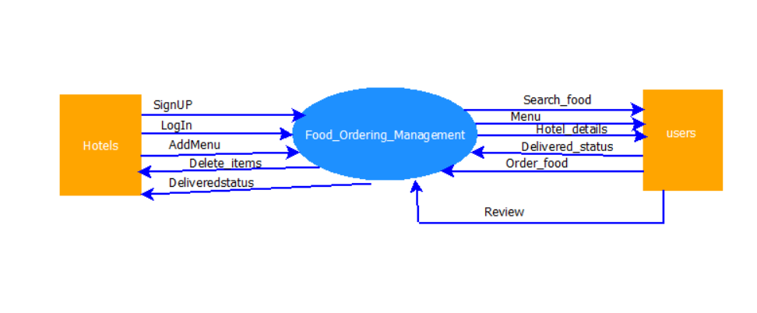
Software Design
DFD Level-0 Diagram:

Slide 10
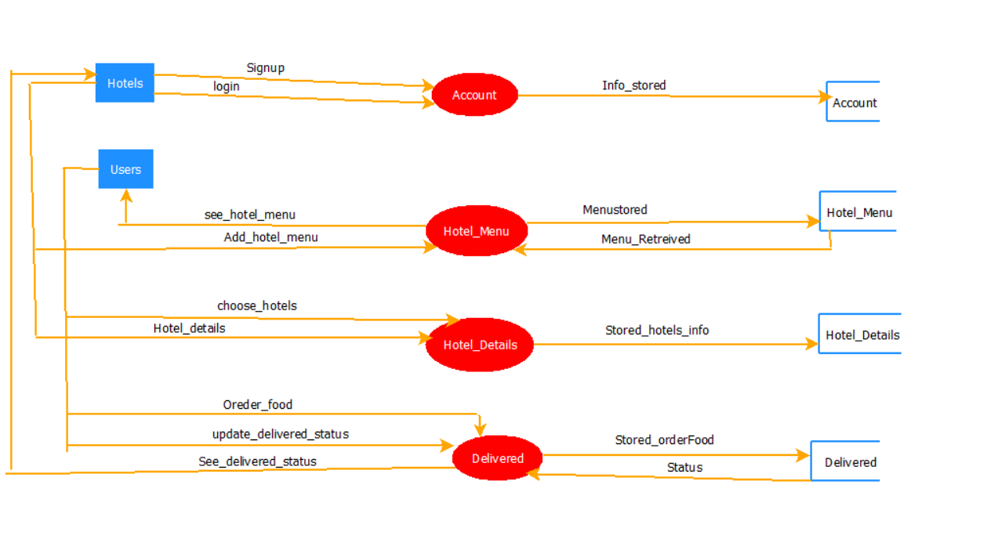
Software Design
DFD Level-1 Diagram:

Slide 11
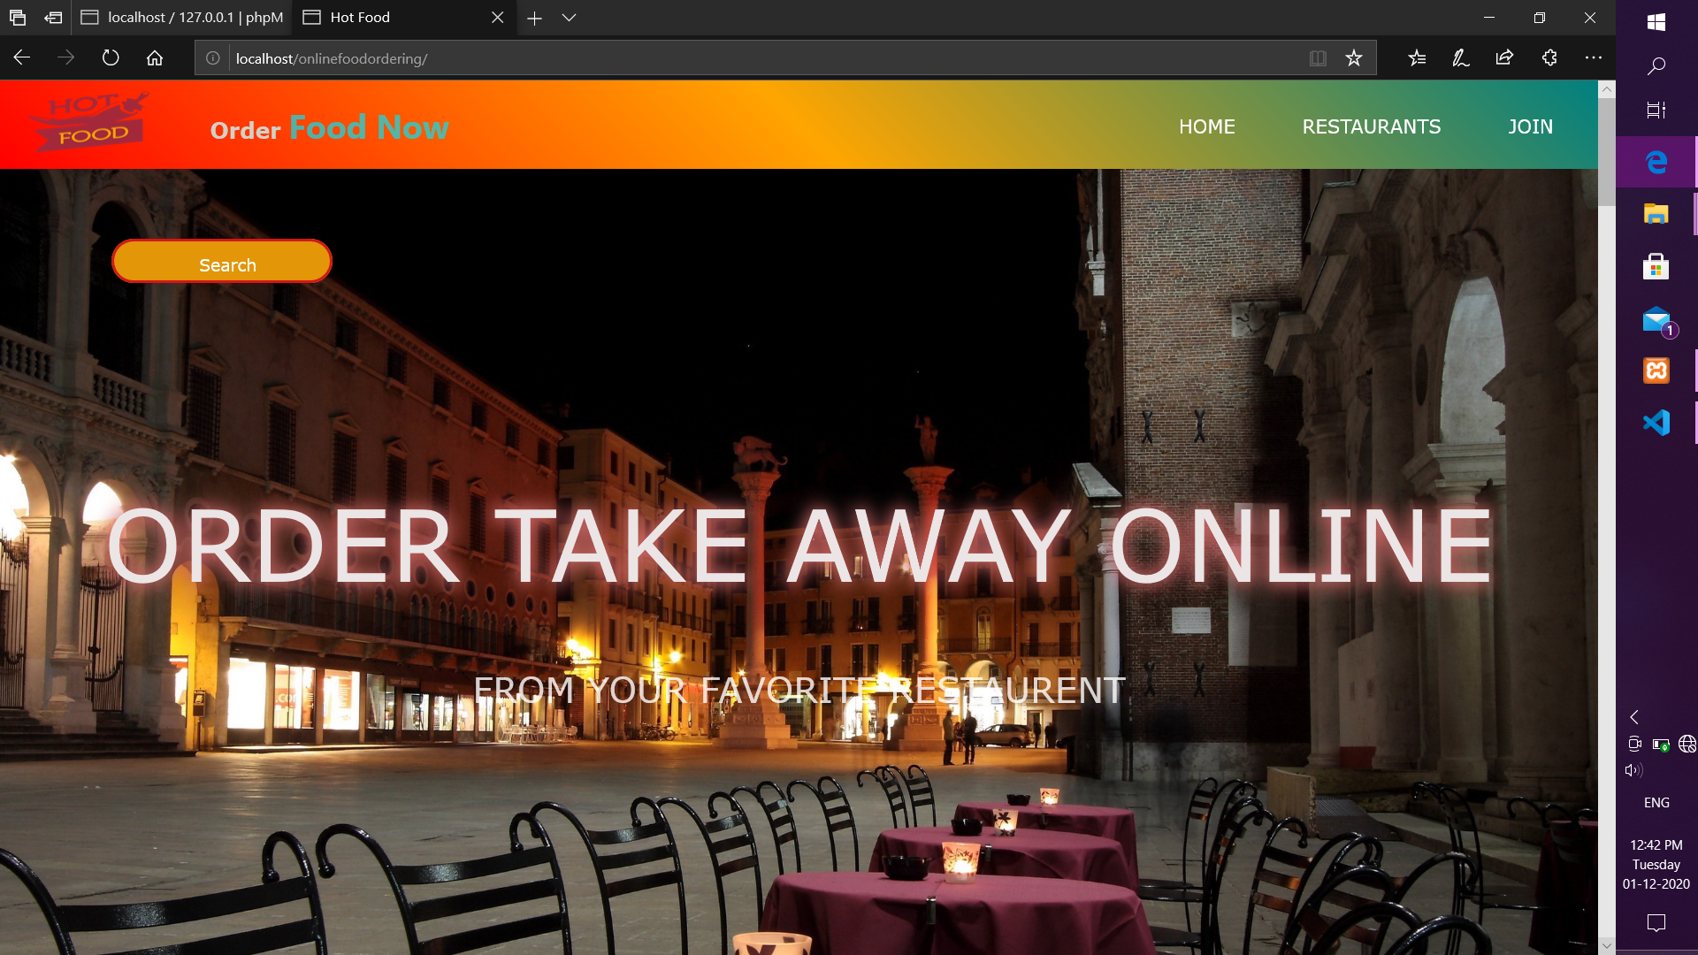
Implementation
1. Home Page:

Slide 12
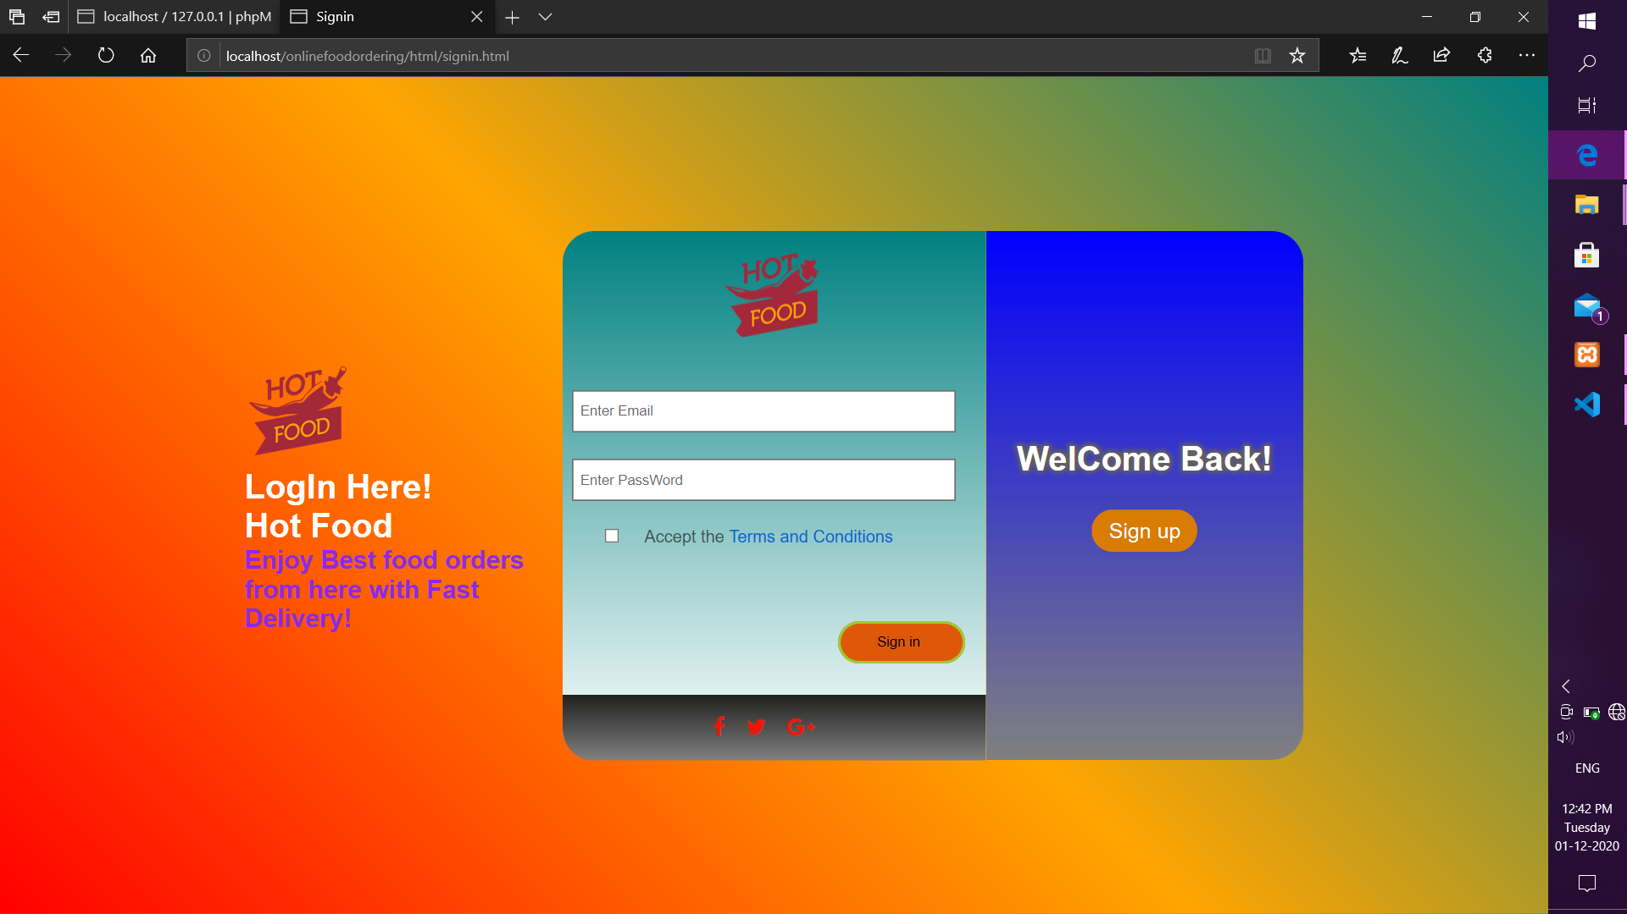
Implementation
2. Login Pages:

Slide 13
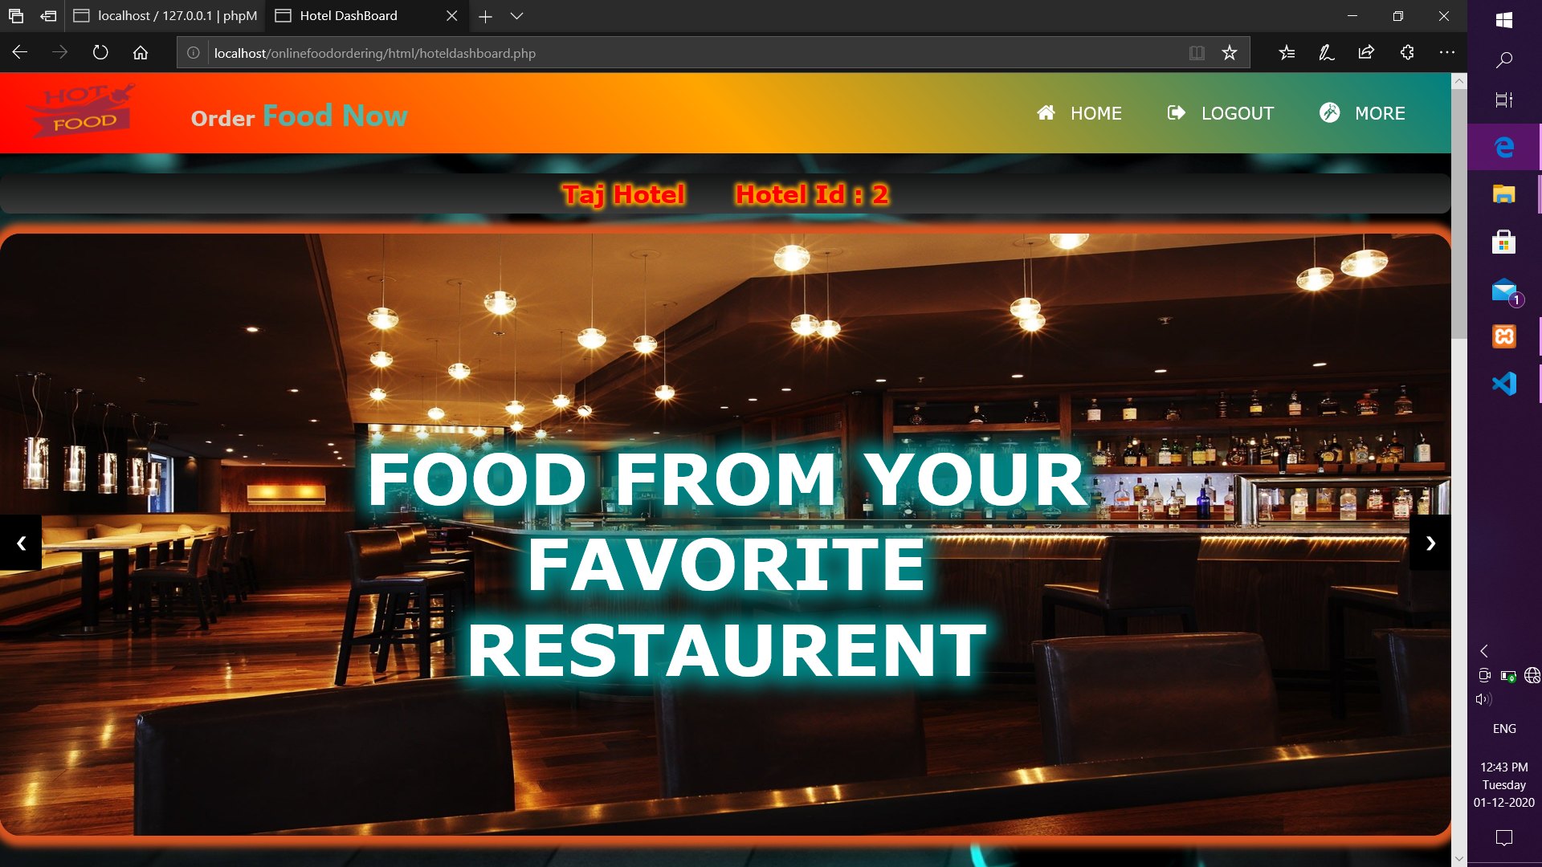
Implementation
3. Hotel Dashboard:

Slide 14
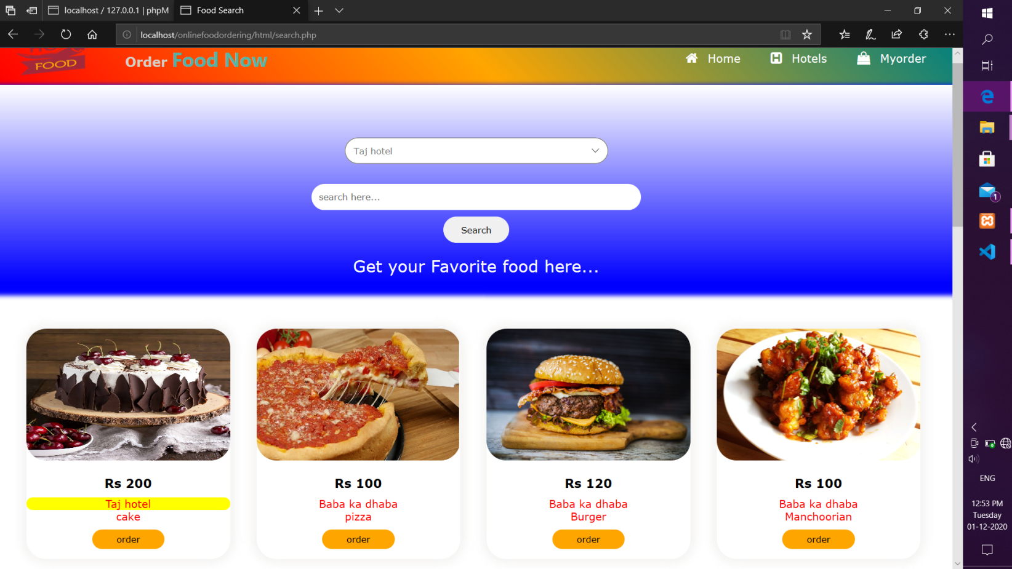
Implementation
4. Searching:

Slide 15
Conclusion
We learned a lot through this project. This project has sharpened our concept of Bootstarp4, html5 , css3, javascipt and php.
After the completion of project, users can view all the hotels and their menu card for ordering the food.
We provides some new feature to this system in future for better accessabilty.

Slide 16
THANK YOU

